Slide 1
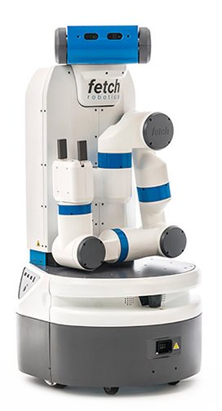
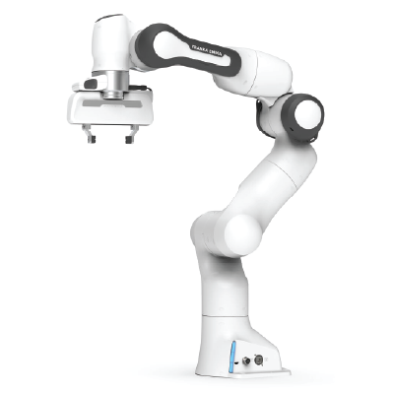

Learning for Interactive Robots Lifelong Robot Library Learning: Bootstrapping Composable and Generalizable Skills for Embodied Control with Language Models
Presenter: Tyler Kim

Slide 2
Overview
Overview of Paper
Background Knowledge
How LRLL works?
Experimental Results
Strengths
Weaknesses
Extensions

Slide 3
I. Overview of Paper

Slide 4
Overview of Paper
Authors: Georgios Tziafas and Hamidreza Kasaei
Motivation: LLMs for generating policy code limit agent to stationary range of addressable tasks
Contributions:
Lifelong Robot Library Learning (LRLL): LLM that grows robot skill library
Dynamic storage and retrieval of past experiences to serve as context
Self-guided exploration policy
Distills recent experiences into new skills
Learn new skills with minimal human online interaction
Bypasses
Model finetuning
Gradient-based optimization

Slide 5
II. Background Knowledge

Slide 6
II. Background Knowledge
Machine Learning: computer systems that can learn and adapt without being explicitly trained
Finetuning: process of finding the best value for nontrainable parameters
Gradient-based optimization: the use of gradients to optimize an objective function
Large Language Models (LLM): a type of machine learning algorithm that generates natural language and others
Bootstrapping: sampling with replacment
General
Abstract Syntax Tree (AST): a tree representation of code
Cluster: a group of objects that are similar to each other
Chain-of-thought: process of approaching a task step-by-step

Slide 7
III. How LRLL Works?

Slide 8
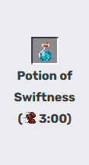
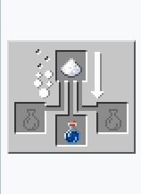


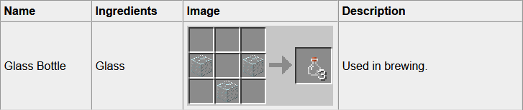


III. How LRLL works?
Outcome
Brewing
Crafting
Killing
Farming/Harvesting
Images from https://minecraft.fandom.com/wiki/Minecraft_Wiki and https://www.minecraftcrafting.info/

Slide 9
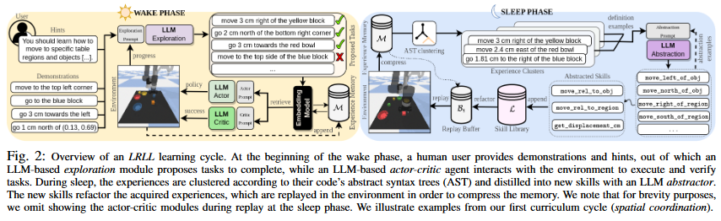


III. How LRLL works?
Lifelong Robot Library Learning or LRLL
Image taken from figure 2 from Tziafas and Kasaei
Wake-Sleep Cycle
Wake: agents interact with environment and users to grow experience
Sleep: agent reflects on experience to expand capabilities
Image from https://www.flaticon.com/free-icon/wake-up_760644 and https://www.freepik.com/icon/enough-sleep_6807803

Slide 10
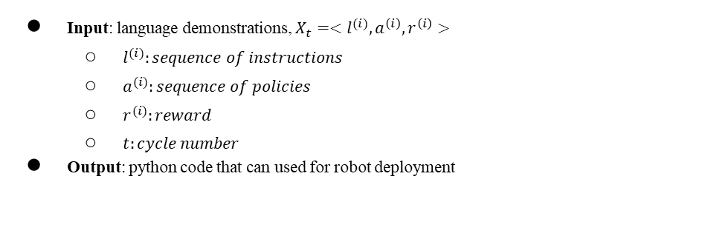
III. How LRLL works?
Image taken from figure 2 from Tziafas and Kasaei
memory
Input: language demonstrations, $X_{t}=<l^{(i)}, a^{\left(i\right)}, r^{\left(i\right)}>$
$l^{(i)}:sequence of instructions$
$a^{(i)}:sequence of policies$
$r^{(i)}:reward$
$t:cycle number$
Output: python code that can used for robot deployment
Notes:
Demos appended to memory
“a” is factorized based on current library skills
“r” way to verify success
Output: python functions

Slide 11
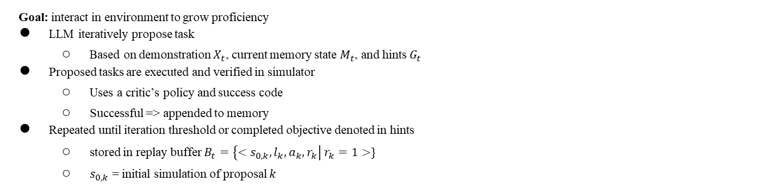
III. How LRLL works?
Image taken from figure 2 from Tziafas and Kasaei
Goal: interact in environment to grow proficiency
LLM iteratively propose task
Based on demonstration $X_{t}$, current memory state $M_{t}$, and hints $G_{t}$
Proposed tasks are executed and verified in simulator
Uses a critic’s policy and success code
Successful => appended to memory
Repeated until iteration threshold or completed objective denoted in hints
stored in replay buffer $B_{t}=\left\{<s_{0,k}, l_{k}, a_{k}, r_{k}\right| r_{k}=1>\}$
$s_{0,k}$ = initial simulation of proposal $k$
Notes:
Agent interacts with environment
Notation
a => factorized based on current skill library
r => success code
l => instruction
LLM iteratively proposes task and pushes to simulator
Executed and verified using another LLM’s generated policy and success code
If successful, push to memory
Entire process repeated until iteration threshold or objectives are complete
Acquired experiences stored in replay buffer: B_t = {<s_{0, k}, l_k, a_k, r_k> | r_k = 1}
s_0,k = initial simulation of proposal k
f

Slide 12
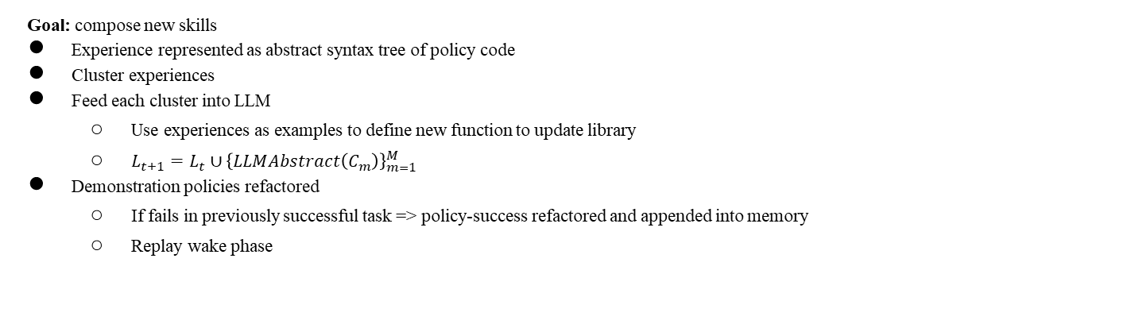
III. How LRLL works?
Image taken from figure 2 from Tziafas and Kasaei
Goal: compose new skills
Experience represented as abstract syntax tree of policy code
Cluster experiences
Feed each cluster into LLM
Use experiences as examples to define new function to update library
$L_{t+1}=L_{t}∪{\left\{LLMAbstract\left(C_{m}\right)\right\}}_{m=1}^{M}$
Demonstration policies refactored
If fails in previously successful task => policy-success refactored and appended into memory
Replay wake phase
Notes:
First created using an abstract syntax tree of policy code
Clustered
Same tree structure modulo variable
Constant names
Clusters fed into LLM => examples in order to define new function to update the library; L_{t+1} = L_t union (LLAbstract of cluster)
If previous task fails => refactored and appended into memory

Slide 13
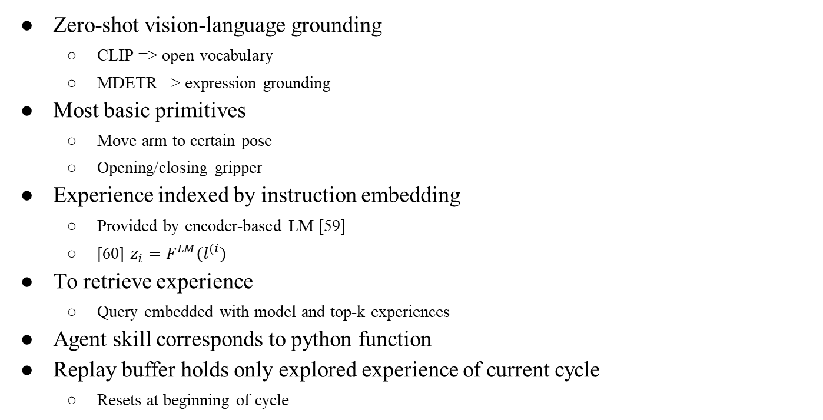
III. How LRLL works?
Zero-shot vision-language grounding
CLIP => open vocabulary
MDETR => expression grounding
Most basic primitives
Move arm to certain pose
Opening/closing gripper
Experience indexed by instruction embedding
Provided by encoder-based LM [59]
[60] $z_{i}=F^{LM}(l^{(i})$
To retrieve experience
Query embedded with model and top-k experiences
Agent skill corresponds to python function
Replay buffer holds only explored experience of current cycle
Resets at beginning of cycle
Notes:
Frozen pretrained vision-language model: CLIP and MDETR
Experiences reflected as instruction-action-success tuple
Indexed by instruction embedding
Query instruction embedded by same model z_q and experience top-k
Skill Library
Replay Buffer
Same as experience memory but only for explored experiences
Exploration
Proposes next task to complete in the simulator
Introduce task variation: alter concepts present in simulator; task compositions: combinations of concepts present in the demos
Skill Abstraction
Maintain same logic code + abstract code variations
Boilerplates => new functions
Prompt
General purpose
API field
Two exemplar function definitions

Slide 14
III. How LRLL works?
LLM Prompts
Comment describing general purpose
API information
Sequence of task-code pairs from retrieved experiences
Chain-of-thoughts provided as comments
Exploration
Variations: alter concepts present in instruction
Compositions: combinations of concepts present in demos
Skill Abstraction
Maintain logic but account for variations
Extract boilerplate snippets and abstract them to new functions

Slide 15
IV. Experimental Results

Slide 16
IV. Experimental Results
Goals
Compare against baselines for tabletop manipulation
Evaluate impact of contributions
Demonstrate transferability

Slide 17
IV. Experimental Results
gpt-3.5-turbo and text-embedding-ada-002
blocks-and-bowls setup replicated from previous works
41 task templates and 4 cycles
Spatial coordination
Visual reasoning
Object manipulation
rearrangement
Task instances
Seen instructions with seen (SA)/unseen (UA) attributes
Unseen instructions with unseen attributes (UI)
For lifelong setup
Forward-transfer
Backward-transfer
Baselines
CLIPort
CaP
LLRL-no-sleep
LLRL-no-wake
Notes:
FT: unseen compositions of tasks
BT: FT tasks from previous cycle

Slide 18
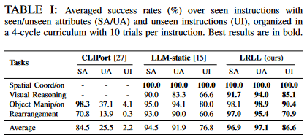
IV. Experimental Results
Tabletop Manipulation
Simulated teacher
Generated 5 demonstrations
1 per seen attribute
Multiple test for each cycle
10 per unseen attributes and unseen attributes with unseen instructions
CLIPort
1k trajectories per task
LLM-static
Demos append to prompt
Image taken from Table I of paper
Notes:
CLIPort struggles with unseen attributes
Performance degrades with unseen instructions
LLM-Static (CAP): robust to unseen attributes; generalize well with unseen instructions; produces non-executable code with unseen instructions at later cycles

Slide 19
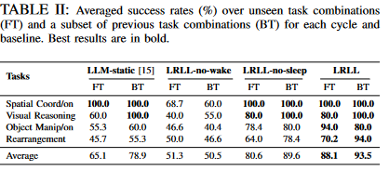
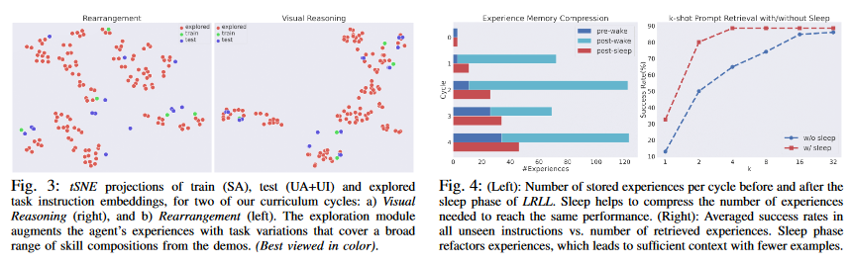
IV. Experimental Results
Ablation
Image taken from Table 2 of paper
Image taken from figures 3 and 4
Notes:
Ablation: study of effect of each proposed component
FT/BT
Table II: all baselines are robust in tasks
No increase in backward task’s performance
FT: LLM-static and LRLL => increase in average success
LRLL-no-sleep => better compositional abilities
Static Prompts vs Retrieval
Later cycles for prompt saturation => hurt LLM; retrieval based baselines ensure fixed context length
Effect of Exploration
Figure 3: LLRL-no-wake struggled across cycles; due to one-one mapping between task and skill
Effect of Abstraction
LLRL-no-sleep never learns new skills
LLRL with sleep: less RAM because less experience
LLM and Embedding Models

Slide 20
V. Strengths

Slide 21
V. Strengths
Good at learning new skills
Memory efficient
Dynamically learn skills for increasing complex situations
Minimal expert intervention
Scalability in learning new skills

Slide 22
VI. Weaknesses

Slide 23
VI. Weaknesses
Limited by choice of vision API
Limited scalability to skills that can be expressed symbolically
Refining initial prompts to exploration/abstraction modules when changing domains or LLM engines
Latency and price

Slide 24
VII. Extensions

Slide 25
VII. Extensions
Authors want investigate gap between GPT and other alternatives
What applications could LRLL have in a more complicated end-effector such as a humanoid hand?
How would a multimodal input affect the number of new skills that LRLL robot could learn?
What are other ways that LRLL can explore and propose different tasks?

Slide 26
Discussion Questions

